Slide 1
Introduction to Data Science and KNN

Slide 2

Hello!
I am Chloe
I am here because I love to teach and am one of AI NI’s
Lead mentors for our Academy meetups.
You can find me at @Chloe_Thomp

Slide 3
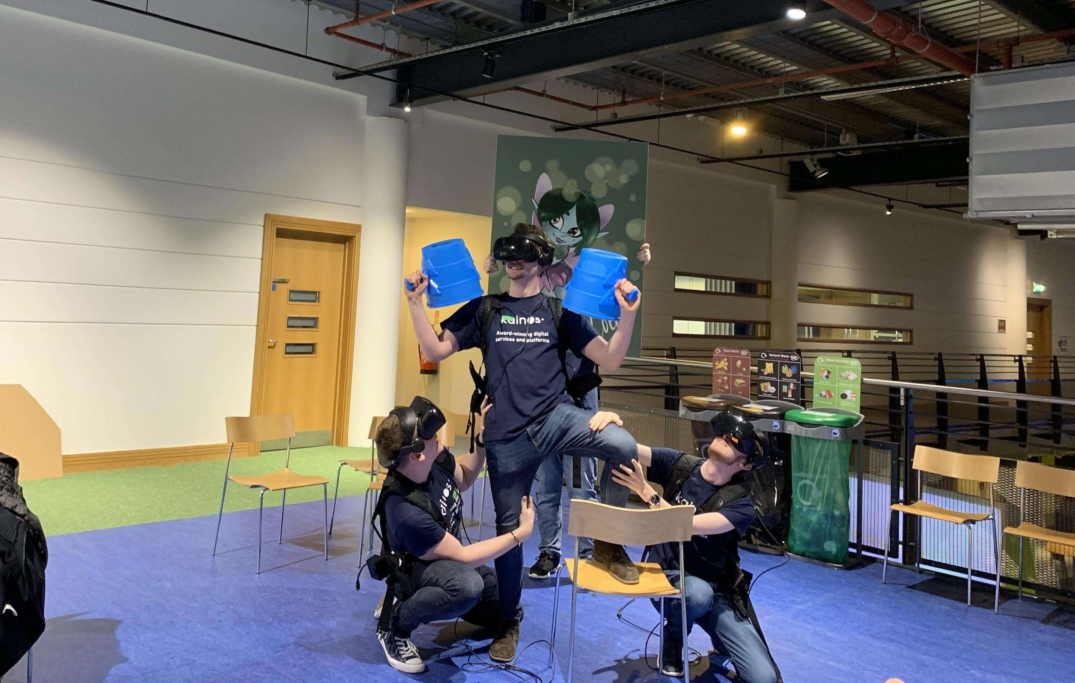
Hello!
I am Jake
I am here because SOMETHING and am one of AI NI’s
Lead mentors for our Academy meetups.
You can find me at @JakeYoung2410

Slide 4
1.
So what is KNN

Slide 5
“KNN is a non-parametric, lazy learning algorithm”

Slide 6
No..but what is it?
Non-parametric
Lazy
It is purely based on feature similarity
Notes:
Non-parametric - means that it does not make any assumptions on the underlying data distribution. Basically, the model structure is determined from the data
This is why it is really good for classification problems.
Lazy - this doesn’t mean it is sleeping on the job, it means that it does not use the training data points to do any generalization. In other words, there is no explicit training phase or it is very minimal. This also means that the training phase is pretty fast .
Prediction is based of the

Slide 7
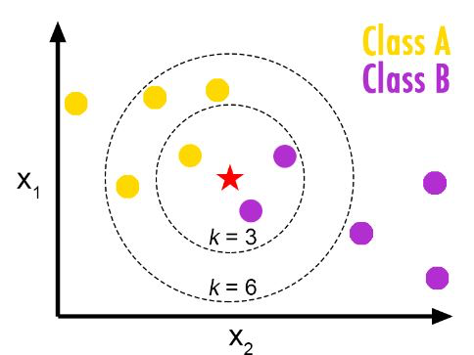
So what does it look like?
Notes:
An object is classified by a majority vote of its neighbors, with the object being assigned to the class most common among its k nearest neighbors.
The number k determines the amount of closest neighbours that we compare our new data point to

Slide 8

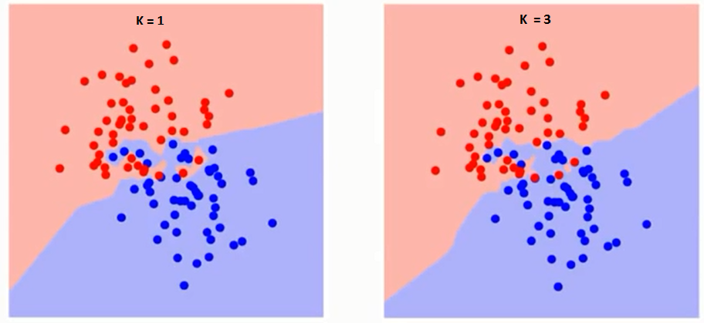
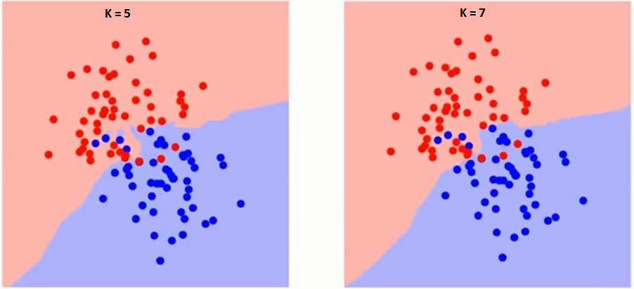
The difference in K
Notes:
On the screen are graphs showing the difference the value k makes when separating two values into their classes.
If you watch carefully, you can see that the boundary becomes smoother with increasing value of K. With K increasing to infinity it finally becomes all blue or all red depending on the total majority. So we have to hit that sweet spot for K that is optimal. When we get into code play about with the value of K to find that value.

Slide 10
Blast Off
That was an awful joke about getting stuck into code…...let’s all just move on…..

Slide 11

Thanks!
Any questions?
Come grab us at any point today!
Or you can find us at:
@Chloe_Thomp
@JakeYoung2410

